Slide 1
WELCOME
Multipurpose Presentation Report For Your Creative Design Agency / Copyright kylyman 2016

Slide 2
Multipurpose Business Slides
+
SNJA SLIDE

Slide 3
Multipurpose Business Slides
MAKE YOUR
PRESENTATION
EFFECTIVE
The printing and typesetting industry when an unknown printer took a galley of type and scrambled it to make a type specimen book unknown printer took a galley of type and

Slide 4
Multipurpose Business Slides
LITTLE ABOUT SNJA SLIDES
Simply dummy text of the printing and typesetting industry when an unknown printer took a galley of type and scrambled it.
The printing and typesetting industry when an unknown printer took a galley of type and scrambled it to make a type specimen book unknown printer took a galley of type and scrambled it to make a type specimen book It has survived not only five centuries.
LEARN MORE

Slide 5
Multipurpose Business Slides
YEARS CORE VALUE
Simply dummy text of the printing and typesetting industry when an unknown printer took a galley of type and scrambled it.
The printing and typesetting industry when an unknown printer took a galley of type and scrambled it to make a type specimen book unknown.
Value 2014 - 2015

Slide 6
Multipurpose Business Slides
c
THINK
l
PLAN
The printing and typesetting industry when an unknown printer took a galley of type and scrambled it to make
The printing and typesetting industry when an unknown printer took a galley of type and scrambled it to make
6
THINK
]
PLAN
The printing and typesetting industry when an unknown printer took a galley of type and scrambled it to make
The printing and typesetting industry when an unknown printer took a galley of type and scrambled it to make
CREATIVE STEP AHEAD

Slide 7
Multipurpose Business Slides
The printing and typesetting industry when an unknown printer took a galley of type and scrambled it to make a type specimen book unknown printer took a galley of type and The printing and typesetting industry when an unknown printer took.
7
BUILD OUR
NATION BUSINESS
=
EXPLORE
OUR BUSINESS
$470,000
$500,000
3
MARKET
DEVELOPMENT
Low Performance
6
IMPROVING
OUR PRODUCTS
Low Performance

Slide 8
Multipurpose Business Slides
SHORT PROGRESS PROJECT
1
Simply dummy text of the printing and typesetting industry when an unknown printer took a galley.
2
Simply dummy text of the printing and typesetting industry when an unknown printer took a galley.
3
Simply dummy text of the printing and typesetting industry when an unknown printer took a galley.
4
Simply dummy text of the printing and typesetting industry when an unknown printer took a galley.

Slide 9
Snja Multipurpose Business Slides
LANDSCAPE PREVIEW IMAGE
The printing and typesetting industry when an unknown printer took a galley of type and scrambled it to make a type specimen book unknown printer took a galley of type and scrambled.
LEARN MORE

Slide 10
Multipurpose Business Slides
THREE KEYS TO SUCCES
The printing and typesetting industry when an unknown printer took a galley of type and scrambled it to make a type specimen book unknown printer took a galley of type and
c
BUILD BUSINESS
Simply dummy text of the printing and typesetting industry when an unknown printer took a galley.
BUILD BUSINESS
6
Simply dummy text of the printing and typesetting industry when an unknown printer took a galley.
]
BUILD BUSINESS
Simply dummy text of the printing and typesetting industry when an unknown printer took a galley.

Slide 11
Multipurpose Business Slides
FOUR KEYS TO SUCCES
The printing and typesetting industry when an unknown printer took a galley of type and scrambled it to make a type specimen book unknown printer took a galley of type and The printing and typesetting industry when an unknown printer took.
c
l
6
]
BUILD BUSINESS
BUILD BUSINESS
BUILD BUSINESS
BUILD BUSINESS
The printing and typesetting dustry when an unknown
The printing and typesetting dustry when an unknown
The printing and typesetting dustry when an unknown
The printing and typesetting dustry when an unknown

Slide 12
Multipurpose Business Slides
SHORT PROGRESS PROJECT
The printing and typesetting industry when an unknown printer took a galley of type and scrambled it to make a type specimen book unknown printer took a galley of type and The printing and typesetting industry when an unknown printer took.
+32
l
c
BUILD BUSINESS
Simply dummy text of the printing and typesetting industry when an unknown printer took a galley.
BUILD BUSINESS
6
Simply dummy text of the printing and typesetting industry when an unknown printer took a galley.
+987,123,421 Total Sales

Slide 13
Multipurpose Business Slides
MAKE YOUR
PRESENTATION EFFECTIVE
The printing and typesetting industry when an unknown printer took a galley of type and scrambled it to make a type specimen book unknown printer took a galley of type and
LEARN MORE

Slide 14
Multipurpose Business Slides
MAKE YOUR
PRESENTATION EFFECTIVE
The printing and typesetting industry when an unknown printer took a galley of type and scrambled it to make a type specimen book unknown printer took a galley of type and
LEARN MORE

Slide 15
Multipurpose Business Slides
MAKE YOUR
PRESENTATION EFFECTIVE
The printing and typesetting industry when an unknown printer took a galley of type and scrambled it to make a type.

Slide 16
Multipurpose Business Slides
+
OUR TEAM

Slide 17
Multipurpose Business Slides
MEET
THE TEAM
The printing and typesetting industry when an unknown printer took a galley of type and scrambled it to make a type specimen book unknown printer took a galley of type and
LEARN MORE

Slide 18
Multipurpose Business Slides
MEET
THE TEAM
The printing and typesetting industry when an unknown printer took a galley of type and scrambled it to make a type specimen book unknown printer took a galley of type and
LEARN MORE
Samuel J Abram
CEO / Creative Director Snja Corporation

Slide 19
Multipurpose Business Slides
OUR
SPECIALIST
Photoshop
HTML / CSS
Wordpress Themes
Samuel J Abram
CEO / Creative Director Snja Corporation

Slide 20
Multipurpose Business Slides
WE ARE
AWESOME
TEAM
LEARN MORE

Slide 21
Multipurpose Business Slides
+
CREATIVE SERVICES

Slide 22
Multipurpose Business Slides
c
DESIGN
PHOTOGRAPH
]
The printing and typesetting industry when an unknown printer took a galley of type and scrambled it to make
The printing and typesetting industry when an unknown printer took a galley of type and scrambled it to make
+
H
UI DESIGN
BRANDING
Z
The printing and typesetting industry when an unknown printer took a galley of type and scrambled it to make
The printing and typesetting industry when an unknown printer took a galley of type and scrambled it to make

Slide 23
Multipurpose Business Slides
OUR CREATIVE
SERVICES
c
DESIGN
PHOTOGRAPH
]
The printing and typesetting industry when an unknown.
The printing and typesetting industry when an unknown.
The printing and typesetting industry when an unknown printer took a galley of type and scrambled it to make a type specimen book unknown printer took a galley of type and
+
LEARN MORE
H
UI DESIGN
BRANDING
Z
The printing and typesetting industry when an unknown.
The printing and typesetting industry when an unknown.

Slide 24
Multipurpose Business Slides
OUT CREATIVE
SERVICES
c
DESIGN
[
PHOTOGRAPH
The printing and typesetting industry when an unknown printer took a galley of type and scrambled it to make
The printing and typesetting industry when an unknown printer took a galley of type and scrambled it to make
The printing and typesetting industry when an unknown printer took a galley of type and scrambled .
6
PROMOTION
8
PRINT
The printing and typesetting industry when an unknown printer took a galley of type and scrambled it to make
The printing and typesetting industry when an unknown printer took a galley of type and scrambled it to make
LEARN MORE

Slide 25
Multipurpose Business Slides
SALES
INFOGRAPHIC
2012
2015
2014
2012 - 2014
2014 - 2016
$13,987,1239
$13,987,1239
The printing and typesetting industry when an unknown printer.
The printing and typesetting industry when an unknown printer.

Slide 26
Multipurpose Business Slides
SAMPLE
INFOGRAPHIC
c
The printing and typesetting industry when an unknown printer took a galley of type and scrambled it to make a type specimen book unknown printer took a galley of type and
c
DESIGN
c
DESIGN
c
DESIGN
The printing and typesetting industry when an unknown.
The printing and typesetting industry when an unknown.
The printing and typesetting industry when an unknown.

Slide 27
Multipurpose Business Slides
SAMPLE INFOGRAPHIC
SUBTITLE TEXT
The printing and typesetting industry when an unknown printer took a galley of type and scrambled it to make a type specimen book unknown printer took a galley of type and
7
-
SUBTITLE TEXT
SUBTITLE TEXT
V
4
SUBTITLE TEXT
SUBTITLE TEXT

Slide 28
Multipurpose Business Slides
SAMPLE INFOGRAPHIC
The printing and typesetting industry when an unknown printer took a galley of type and scrambled it to make a type specimen book unknown printer took a galley of type and
7
+987,9871 Sales per Month
Multipurpose Business Slides

Slide 29
Multipurpose Business Slides
SAMPLE INFOGRAPHIC
77%
60%
33%
c
DESIGN
c
DESIGN
c
DESIGN
The printing and typesetting industry when an unknown.
The printing and typesetting industry when an unknown.
The printing and typesetting industry when an unknown.

Slide 30
Multipurpose Business Slides
SAMPLE INFOGRAPHIC
SUBTITLE TEXT
The printing and typesetting industry when an unknown printer took a galley of type and scrambled it to make a type specimen book unknown printer took a galley of type and
Value
VS
Value
2012
2015
+91,194,123
+9,091,124

Slide 31
Multipurpose Business Slides
SAMPLE INFOGRAPHIC
SUBTITLE TEXT
The printing and typesetting industry when an unknown printer took a galley of type and scrambled it to make a type specimen book unknown printer took a galley of type and
2012 - 2014
2014 - 2016
$13,987,1239
$13,987,1239
The printing and typesetting industry when an unknown printer.
The printing and typesetting industry when an unknown printer.

Slide 32
Multipurpose Business Slides
SAMPLE INFOGRAPHIC
SUBTITLE TEXT
The printing and typesetting industry when an unknown printer took a galley of type and scrambled it to make a type specimen book unknown printer took a galley of type and
z
JUNE
Value
VS
Value
5
APRIL
3
MARCH
2012
2015
+91,194,123
+91,194,123
876,876,124
876,876,124
876,876,124

Slide 33
Multipurpose Business Slides
SAMPLE INFOGRAPHIC
SUBTITLE TEXT
The printing and typesetting industry when an unknown printer took a galley of type and scrambled it to make a type specimen book unknown printer took a galley of type and
7
-
SUBTITLE TEXT
SUBTITLE TEXT
V
4
SUBTITLE TEXT
SUBTITLE TEXT

Slide 34
Multipurpose Business Slides
PRICING
TABLE LIST
Regular
Premium
Gold
1x Servicec
100 Services
Unlimited Services
24/7 Support
8745 Services
1x Servicec
100 Services
Unlimited Services
24/7 Support
8745 Services
1x Servicec
100 Services
Unlimited Services
24/7 Support
8745 Services
The printing and typesetting industry when an unknown printer took a galley of type and scrambled it to make a type specimen book unknown.
LEARN MORE
$32
$72
$119

Slide 35
Multipurpose Business Slides
+
COMPANY TIMELINE

Slide 36
Multipurpose Business Slides
BUILD STARTUP
c
2011-2012
The printing and typesetting industry when an unknown printer took a galley of type and scrambled it to make a type specimen book unknown.

Slide 37
Multipurpose Business Slides
GROW
THE COMPANY
R
2013-2014
The printing and typesetting industry when an unknown printer took a galley of type and scrambled it to make a type specimen book unknown.

Slide 38
Multipurpose Business Slides
c
MAKE PROTOTIPE
The printing and typesetting industry when an unknown printer took a galley of type and scrambled.
MORE THAN COMPANY
c
The printing and typesetting industry when an unknown printer took a galley of type and scrambled.

Slide 39
Multipurpose Business Slides
OVER 1 MILLION
AROUND THE WORLD
E
2013-2014
The printing and typesetting industry when an unknown printer took a galley of type and scrambled it to make a type specimen book unknown.

Slide 40
Multipurpose Business Slides
HERE WE ARE
C
2011-2012
The printing and typesetting industry when an unknown printer took a galley of type and scrambled it to make a type specimen book unknown.

Slide 41
OUR PORTFOLIO
LEARN MORE

Slide 42
01 IMAGE
03 IMAGE
LEARN MORE
LEARN MORE
02 IMAGE
04 IMAGE
LEARN MORE
LEARN MORE

Slide 43
Multipurpose Business Slides
PORTFOLIO
RIGHT PICTURE 01
LEARN MORE

Slide 44
Multipurpose Business Slides
PORTFOLIO
LEFT PICTURE 02
LEARN MORE

Slide 45
PORTFOLIO
LEFT PICTURE 01
The printing and typesetting industry when an unknown printer took a galley of type and scrambled it to make a type specimen book unknown.
PORTFOLIO
RIGHT PICTURE 02
The printing and typesetting industry when an unknown printer took a galley of type and scrambled it to make a type specimen book unknown.

Slide 46
PORTFOLIO
RIGHT PICTURE 02
The printing and typesetting industry when an unknown printer took a galley of type and scrambled it to make a type specimen book unknown.
LEARN MORE
PORTFOLIO
RIGHT PICTURE 02
The printing and typesetting industry when an unknown printer took a galley of type and scrambled it to make a type specimen book unknown.
LEARN MORE

Slide 47
Multipurpose Business Slides
PORTFOLIO
LEFT PICTURE 01
The printing and typesetting industry when an unknown printer took a galley of type and scrambled it to make a type specimen book unknown printer took a galley of type and The printing and typesetting industry when an unknown printer took.
LEARN MORE

Slide 48
Multipurpose Business Slides
PORTFOLIO
RIGHT PICTURE 02
The printing and typesetting industry when an unknown printer took a galley of type and scrambled it to make a type specimen book unknown printer took a galley of type and The printing and typesetting industry when an unknown printer took.
LEARN MORE

Slide 49
PORTFOLIO
LEFT PICTURE 01
PORTFOLIO
RIGHT PICTURE 01
The printing and typesetting industry when an unknown printer took a galley of type and scrambled it to make a type specimen book.
The printing and typesetting industry when an unknown printer took a galley of type and scrambled it to make a type specimen book unknown printer took.

Slide 50
Multipurpose Business Slides
PORTFOLIO
HALF BOTTOM
The printing and typesetting industry when an unknown printer took a galley of type and scrambled it to make a type specimen book unknown printer took a galley of type and
snjapresentation

Slide 51
Multipurpose Business Slides
PORTFOLIO
HALF HEADLINE
The printing and typesetting industry when an unknown printer took a galley of type and scrambled it to make a type specimen book unknown printer took a galley of type and
LEARN MORE

Slide 52
PORTFOLIO
HALF BOTTOM
LEARN MORE

Slide 53
PORTFOLIO
INFOGRAPHIC
PORTFOLIO STATISTIC
]
Multipurpose Business Slides
37
37
37
37
37
37
37
37

Slide 54
01 IMAGE
02 IMAGE
The printing and typesetting industry when an unknown printer took a galley of type and scrambled.
The printing and typesetting industry when an unknown printer took a galley of type and scrambled.
03 IMAGE
04 IMAGE
The printing and typesetting industry when an unknown printer took a galley of type and scrambled.
The printing and typesetting industry when an unknown printer took a galley of type and scrambled.

Slide 55
Multipurpose Business Slides
OUR LASTEST
PROJECT
The printing and typesetting industry when an unknown printer took a galley of type and scrambled it to make.
PICTURE 01
BOTTOM LEFT
LEARN MORE

Slide 56
Multipurpose Business Slides
OUR LASTEST PROJECT
The printing and typesetting industry when an unknown printer took a galley of type and scrambled it to make a type specimen book unknown printer took a galley of type and
PICTURE 02
BOTTOM RIGHT
LEARN MORE

Slide 57
Multipurpose Business Slides
OUR LASTEST
CLIENT
LOGO 1
LOGO 2
LOGO 3
c
7
b
The printing and typesetting industry when an unknown printer took a galley of type and scrambled it to make.
9
5
l
LEARN MORE
LOGO 4
LOGO 5
LOGO 6

Slide 58
Multipurpose Business Slides
Clint James Arthur
WHAT OUR
CLIENT SAY
LEARN MORE
CEO Itech Corporation
“ The printing and typesetting industry when an unknown printer took a galley of type and scrambled it to make a type. “

Slide 59
Multipurpose Business Slides
+
PRODUCT MOCKUP

Slide 60

Multipurpose Business Slides
PRODUCT
PHONE MOCKUP
+
The printing and typesetting industry when an unknown the printer took a galley of type and scrambled it to make printing and typesetting industry when an unknown.
DEMO 1
DEMO 2

Slide 61
Multipurpose Business Slides
PRODUCT
PHONE MOCKUP
+
c
SUBTILE 1
l
SUBTITLE 2
The printing and typesetting industry when an unknown printer took a galley.
The printing and typesetting industry when an unknown printer took a galley.
6
SUBTITLE 3
]
SUBTITLE 4
The printing and typesetting industry when an unknown printer took a galley.
The printing and typesetting industry when an unknown printer took a galley.

Slide 62

Multipurpose Business Slides
PRODUCT PHONE MOCKUP
+
+
SUBTITLE TEXT
The printing and typesetting industry when an unknown printer took a galley of type and scrambled it to make a type specimen book unknown printer took a galley of type and
GO TO MARKET STORE
VIEW THE DEMO

Slide 63
PRODUCT PHONE MOCKUP
Multipurpose Business Slides
SUBTITLE TEXT
7
V
SUBTITLE TEXT
The printing and typesetting industry when an unknown printer took a galleY.
The printing and typesetting industry when an unknown printer took a galleY.
+
SUBTITLE TEXT
-
4
SUBTITLE TEXT
The printing and typesetting industry when an unknown printer took a galleY.
The printing and typesetting industry when an unknown printer took a galleY.

Slide 64

PRODUCT NOTEBOOK MOCKUP
Multipurpose Business Slides
SUBTITLE TEXT
7
V
SUBTITLE TEXT
The printing and typesetting industry when an unknown printer took a galleY.
+
The printing and typesetting industry when an unknown printer took a galleY.
SUBTITLE TEXT
SUBTITLE TEXT
-
4
The printing and typesetting industry when an unknown printer took a galleY.
The printing and typesetting industry when an unknown printer took a galleY.
LEARN MORE

Slide 65

Multipurpose Business Slides
PRODUCT
DESKTOP MOCKUP
SUBTITLE TEXT
The printing and typesetting industry when an unknown printer took a galley of type and scrambled it to make a type specimen book unknown printer took a galley of type and
SUBTITLE TEXT
The printing and typesetting industry when an unknown printer took a galley of type and scrambled it to make a type specimen book unknown printer took a galley of type and
+
7
-
V
4

Slide 66

PRODUCT PHONE MOCKUP
Multipurpose Business Slides
+
+
+
7
-
V
4
SUBTITLE TEXT
SUBTITLE TEXT
SUBTITLE TEXT
SUBTITLE TEXT

Slide 67
Multipurpose Business Slides
PRODUCT
DESKTOP MOCKUP
SUBTITLE TEXT
The printing and typesetting industry when an unknown printer took a galley of type and scrambled it to make a type specimen book unknown printer took a galley of type and
7
-
+
SUBTITLE TEXT
SUBTITLE TEXT
APPLICATION DESKTOP VERSION 1.9
V
4
SUBTITLE TEXT
SUBTITLE TEXT

Slide 68
Multipurpose Business Slides
PRODUCT
DESKTOP MOCKUP
SUBTITLE TEXT
The printing and typesetting industry when an unknown printer took a galley of type and scrambled it to make a type specimen book unknown printer took a galley of type and
7
-
+
SUBTITLE TEXT
SUBTITLE TEXT
V
4
+
SUBTITLE TEXT
SUBTITLE TEXT

Slide 69
Multipurpose Business Slides
PRODUCT
DESKTOP MOCKUP
SUBTITLE TEXT
The printing and typesetting industry when an unknown printer took a galley of type and scrambled it to make a type specimen book unknown.
7
+
SUBTITLE TEXT
APPLICATION DESKTOP VERSION 1.9
-
SUBTITLE TEXT
V
SUBTITLE TEXT

Slide 70
PRODUCT PHONE MOCKUP
Multipurpose Business Slides
The printing and typesetting industry when an unknown printer took a galley of type and scrambled it to make a type specimen book unknown printer took a galley of type and when an unknown printer took a galley of type and scrambled it to make a type specimen book unknown printer took a galley
SUBTITLE TEXT
7
7
SUBTITLE TEXT
The printing and typesetting industry when an unknown printer took a galley.
The printing and typesetting industry when an unknown printer took a galleY.
SUBTITLE TEXT
7
7
SUBTITLE TEXT
The printing and typesetting industry when an unknown printer took a galley.
+
The printing and typesetting industry when an unknown printer took a galleY.

Slide 71

Multipurpose Business Slides
PRODUCT PHONE + PAD MOCKUP
+
APPLICATION DESKTOP VERSION 1.9
1
The printing and typesetting industry when an unknown printer took a galleY.
+
2
The printing and typesetting industry when an unknown printer took a galleY.
3
The printing and typesetting industry when an unknown printer took a galleY.

Slide 72
Multipurpose Business Slides
PRODUCT
DESKTOP MOCKUP
The printing and typesetting industry when an unknown printer took a galley of type and scrambled it to make.
+
V
SUBTITLE TEXT
The printing and typesetting industry when an unknown printer took a galleY.
4
SUBTITLE TEXT
The printing and typesetting industry when an unknown printer took a galleY.
Display Tablet Application Mockup

Slide 73
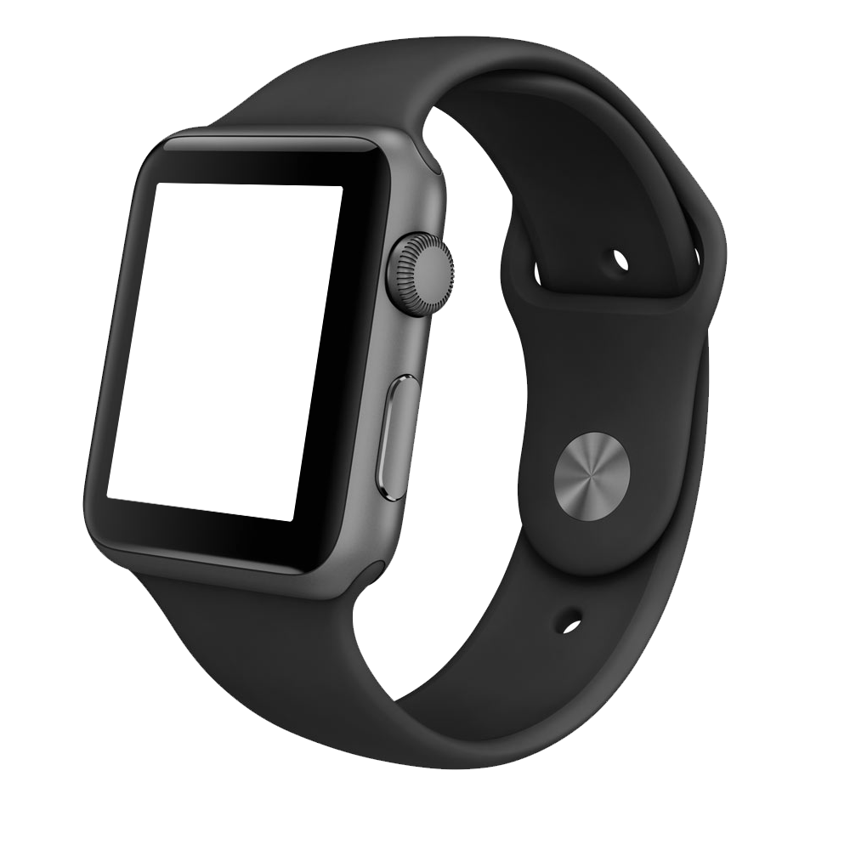
Multipurpose Business Slides
PRODUCT
SMARTWATCH MOCKUP
1
The printing and typesetting industry when an unknown printer took a galleY.
2
The printing and typesetting industry when an unknown printer took a galleY.
3
The printing and typesetting industry when an unknown printer took a galleY.

Slide 74
Multipurpose Business Slides
PRODUCT
SMARTWATCH MOCKUP
The printing and typesetting industry when an unknown printer took a galley of type and scrambled it to make.
V
SUBTITLE TEXT
The printing and typesetting industry when an unknown printer took a galleY.
4
SUBTITLE TEXT
The printing and typesetting industry when an unknown printer took a galleY.
Display Tablet Application Mockup

Slide 75
Multipurpose Business Slides
+
GLOBAL MAPS

Slide 76
Multipurpose Business Slides
GLOBAL
AMERICA MAPS
MARKET
68%
6,000,000
6 MILLION
The printing and typesetting industry when an unknown printer took a galleY.

Slide 77
Multipurpose Business Slides
GLOBAL
AMERICA MAPS
Simpley Dummy Text
68%
Printing out simpley
Simpley Dummy Text
6 Million
Printing out simpley
Simpley Dummy Text
6,000,000
Printing out simpley
V
SUBTITLE TEXT
The printing and typesetting industry when an unknown printer took a galleY.
4
SUBTITLE TEXT
The printing and typesetting industry when an unknown printer took a galleY.
3
SUBTITLE TEXT
The printing and typesetting industry when an unknown printer took a galleY.

Slide 78
Multipurpose Business Slides
GLOBAL
ASIA MAPS
The printing and typesetting industry when an unknown printer took a galley of type and scrambled it to make.
2012
2013
2014
2015
8.3
6.9
7.3
9.2

Slide 79
Multipurpose Business Slides
GLOBAL
ASIA MAPS
SUBTITLE TEXT
The printing and typesetting industry when an unknown printer took a galley of type and scrambled it to make a type specimen book unknown printer took a galley of type and
7
-
SUBTITLE TEXT
SUBTITLE TEXT
V
4
SUBTITLE TEXT
SUBTITLE TEXT

Slide 80
Multipurpose Business Slides
GLOBAL
AUSTRALIA MAPS
SUBTITLE TEXT
The printing and typesetting industry when an unknown printer took a galley of type and scrambled it to make a type specimen book unknown printer took a galley of type and
68%
6,000,000
6 MILLION
The printing and typesetting industry when an unknown printer took a galleY.

Slide 81
Multipurpose Business Slides
GLOBAL
AUSTRALIA MAPS
Value
VS
Value
2012
2015
+98,987,981
+101,987,765

Slide 82
Multipurpose Business Slides
GLOBAL
WORLD MAPS
V
SUBTITLE TEXT
The printing and typesetting industry when an unknown printer took a galley.
4
SUBTITLE TEXT
The printing and typesetting industry when an unknown printer took a galley.
3
SUBTITLE TEXT
The printing and typesetting industry when an unknown printer took a galley.
2
SUBTITLE TEXT
The printing and typesetting industry when an unknown printer took a galley.

Slide 83
Multipurpose Business Slides
01
SECTION BREAKS

Slide 84
Multipurpose Business Slides
02
SECTION BREAKS

Slide 85
03
SECTION BREAKS

Slide 86
04
SECTION BREAKS
BREAK FOR A WHILE

Slide 87
THANKS FOR WATCHING
+
Multipurpose Presentation Report For Your Creative Design Agency / Copyright kylyman 2016

Slide 88
THANKS FOR WATCHING
Multipurpose Presentation Report For Your Creative Design Agency / Copyright kylyman 2016

Slide 89
1234567890-=
QWERTYUIOP[]
\ASDFGHJKL;’
ZXCVBNM,./12
7890-=qwerty
Uiop[]\asdfg

Slide 90
34567890-=Qw
Ertyuiop]\As
Dfghjkl;Zxcv
bnm,./123456
Jkl;’zxcvbnm

Slide 91
34567890-=Qw
Ertyuiop]\As
Dfghjkl;Zxcv
bnm,./123456
Jkl;’zxcvbnm

